Slide 1
DIP Application
การประมวลผลสัญญาณภาพดิจิตอล
พงศกร เจริญเนตรกุล

Slide 2
References
SVETLANA LAZEBNIK, Lecture Note (lec23_face_detection) Department of Computer Science, University of North Carolina at Chapel Hill
https://www.learnopencv.com/histogram-of-oriented-gradients/
https://iq.opengenus.org/object-detection-with-histogram-of-oriented-gradients-hog/

Slide 3
0. Outline
Face Detection & Object Detection
Haar-Like cascade of classifier - Paul Viola, et al.
Histogram of Oriented Gradients (HOG)
Segmentation
Segnet
Generative Adversarial Networks
Super Resolution / Fill-Generate new data with different properties
Pose Estimation - openpose

Slide 4
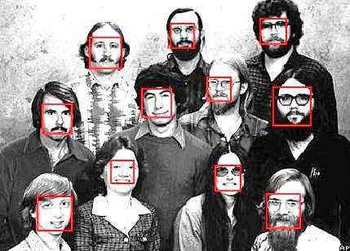
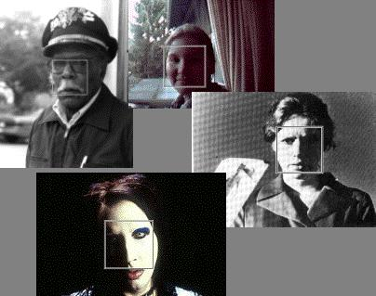
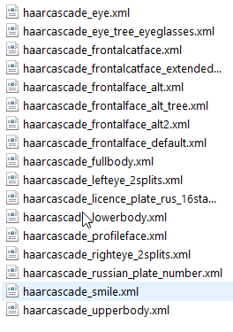
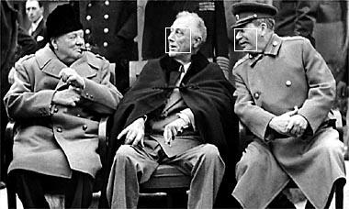
1.The beginning “face detector”
Many slides adapted from P. Viola

Slide 5
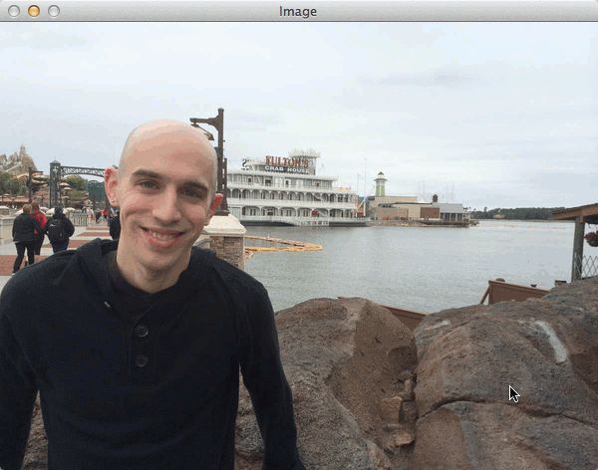
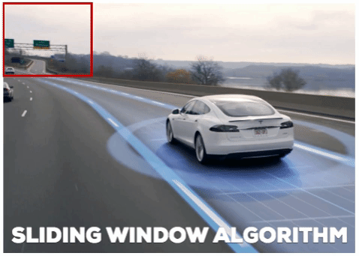
2.Sliding window search with multi-scale
Sliding window for search object with multi-scale windows and/or pyramid images.
Image Ref: https://www.pyimagesearch.com/2015/03/23/sliding-windows-for-object-detection-with-python-and-opencv/
https://towardsdatascience.com/evolution-of-object-detection-and-localization-algorithms-e241021d8bad

Slide 6
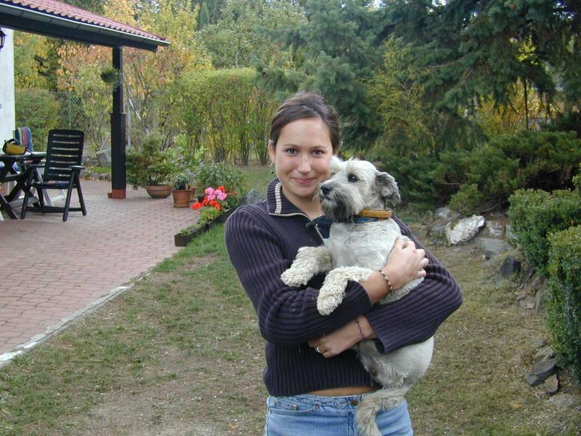
2.Sliding window search with multi-scale
Basic idea: slide a window across image and evaluate a face model at every location

Slide 7
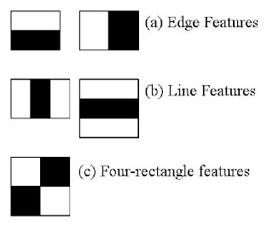
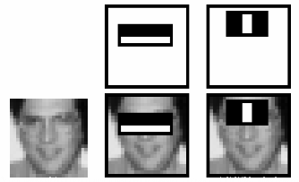
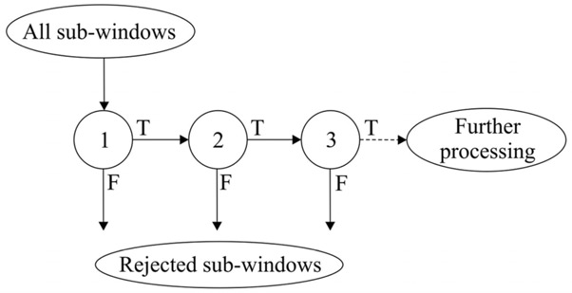
3.A Famous Object Detection -> Paul Viola, et al.
Real-time Object Detection
Training slowly – fast detection
Ideas
3.1) Haar-Like Features – Rapidly encode (calculation) features with Integral Image
3.2) AdaBoost - Features Selection
3.3) Cascade of Classification
P. Viola and M. Jones. Rapid object detection using a boosted cascade of simple features. CVPR 2001.
P. Viola and M. Jones. Robust real-time face detection. IJCV 57(2), 2004.

Slide 8
3.A Famous Object Detection -> Paul Viola, et al.
3.1) Haar-Like Features – Rapidly encode (calculation) features with Integral Image
The integral image computes a value at each pixel (x,y) that is the sum of the pixel values above and to the left of (x,y), inclusive
This can quickly be computed in one pass through the image
(x,y)
P. Viola and M. Jones. Rapid object detection using a boosted cascade of simple features. CVPR 2001.
P. Viola and M. Jones. Robust real-time face detection. IJCV 57(2), 2004.

Slide 9
3.A Famous Object Detection -> Paul Viola, et al.
3.1) Haar-Like Features – Rapidly encode (calculation) features with Integral Image
Let A,B,C,D be the values of the integral image at the corners of a rectangle
Then the sum of original image values within the rectangle can be computed as:
sum = A – B – C + D
Only 3 additions are required for any size of rectangle!
D
B
C
A
P. Viola and M. Jones. Rapid object detection using a boosted cascade of simple features. CVPR 2001.
P. Viola and M. Jones. Robust real-time face detection. IJCV 57(2), 2004.

Slide 10
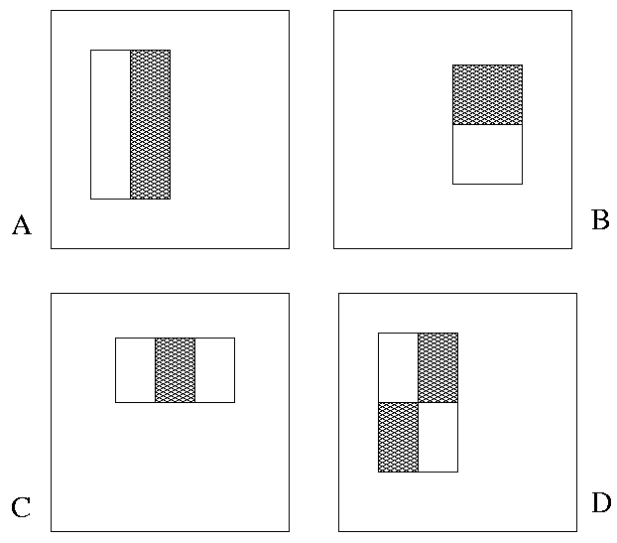
3.A Famous Object Detection -> Paul Viola, et al.
3.1) Haar-Like Features – Rapidly encode (calculation) features with Integral Image
“Rectangle filters”
Value = ∑ (pixels in white area) – ∑ (pixels in black area)
P. Viola and M. Jones. Rapid object detection using a boosted cascade of simple features. CVPR 2001.
P. Viola and M. Jones. Robust real-time face detection. IJCV 57(2), 2004.

Slide 11

3.A Famous Object Detection -> Paul Viola, et al.
3.1) Haar-Like Features – Rapidly encode (calculation) features with Integral Image
P. Viola and M. Jones. Rapid object detection using a boosted cascade of simple features. CVPR 2001.
P. Viola and M. Jones. Robust real-time face detection. IJCV 57(2), 2004.

Slide 12
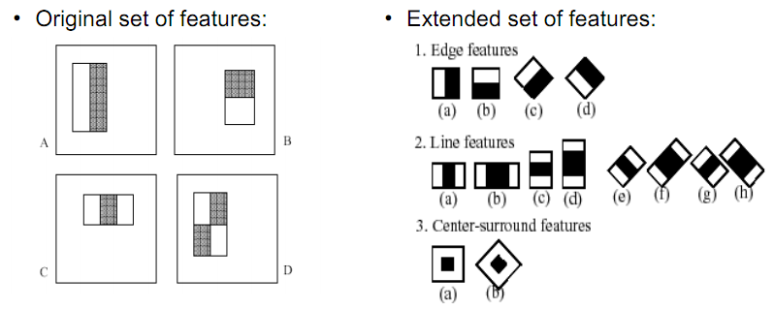
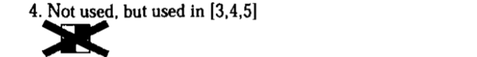
3.A Famous Object Detection -> Paul Viola, et al.
3.1) Haar-Like Features – Rapidly encode (calculation) features with Integral Image
R. Lienhart and J. Maydt, "An extended set of Haar-like features for rapid object detection," Proceedings. International Conference on Image Processing, Rochester, NY, USA, 2002
P. Viola and M. Jones. Rapid object detection using a boosted cascade of simple features. CVPR 2001.
P. Viola and M. Jones. Robust real-time face detection. IJCV 57(2), 2004.

Slide 13
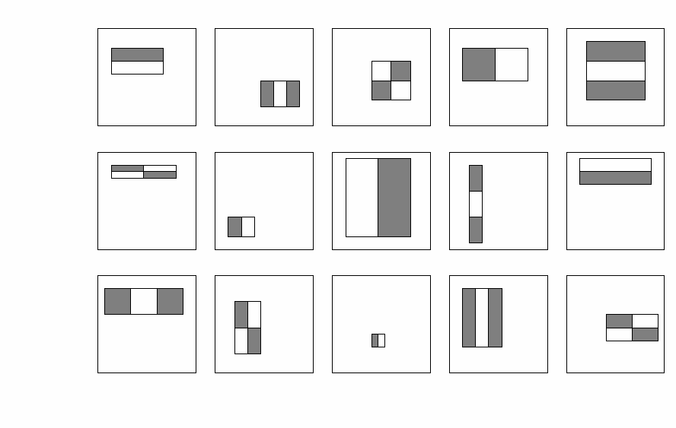
3.A Famous Object Detection -> Paul Viola, et al.
3.1) Haar-Like Features – Rapidly encode (calculation) features with Integral Image
Just for a 24x24 detection area, will generated the number of possible rectangle features is ~160,000!
Which are the set that contain best features?
P. Viola and M. Jones. Rapid object detection using a boosted cascade of simple features. CVPR 2001.
P. Viola and M. Jones. Robust real-time face detection. IJCV 57(2), 2004.

Slide 14
3.A Famous Object Detection -> Paul Viola, et al.
3.2) AdaBoost - Features Selection
Boosting is a classification scheme that works by combining weak learners into a more accurate ensemble classifier
A weak learner need only do better than chance
Training consists of multiple boosting rounds
During each boosting round, we select a weak learner that does well on examples that were hard for the previous weak learners
“Hardness” is captured by weights attached to training examples
Y. Freund and R. Schapire, A short introduction to boosting, Journal of Japanese Society for Artificial Intelligence, 14(5):771-780, September, 1999.
P. Viola and M. Jones. Rapid object detection using a boosted cascade of simple features. CVPR 2001.
P. Viola and M. Jones. Robust real-time face detection. IJCV 57(2), 2004.

Slide 15
3.A Famous Object Detection -> Paul Viola, et al.
3.2) AdaBoost - Features Selection
Training Step
Initially, weight each training example equally
In each boosting round:
Find the weak learner that achieves the lowest weighted training error
Raise the weights of training examples misclassified by current weak learner
Compute final classifier as linear combination of all weak learners (weight of each learner is directly proportional to its accuracy)
Exact formulas for re-weighting and combining weak learners depend on the particular boosting scheme (e.g., AdaBoost, XGBoost, Gradient Boosted, Decision Trees)
Y. Freund and R. Schapire, A short introduction to boosting, Journal of Japanese Society for Artificial Intelligence, 14(5):771-780, September, 1999.
P. Viola and M. Jones. Rapid object detection using a boosted cascade of simple features. CVPR 2001.
P. Viola and M. Jones. Robust real-time face detection. IJCV 57(2), 2004.

Slide 16
3.A Famous Object Detection -> Paul Viola, et al.
3.2) AdaBoost - Features Selection
Weak
Classifier 1
Y. Freund and R. Schapire, A short introduction to boosting, Journal of Japanese Society for Artificial Intelligence, 14(5):771-780, September, 1999.
P. Viola and M. Jones. Rapid object detection using a boosted cascade of simple features. CVPR 2001.
P. Viola and M. Jones. Robust real-time face detection. IJCV 57(2), 2004.

Slide 17
3.A Famous Object Detection -> Paul Viola, et al.
3.2) AdaBoost - Features Selection
Weights
Increased
Y. Freund and R. Schapire, A short introduction to boosting, Journal of Japanese Society for Artificial Intelligence, 14(5):771-780, September, 1999.
P. Viola and M. Jones. Rapid object detection using a boosted cascade of simple features. CVPR 2001.
P. Viola and M. Jones. Robust real-time face detection. IJCV 57(2), 2004.

Slide 18
3.A Famous Object Detection -> Paul Viola, et al.
3.2) AdaBoost - Features Selection
Weak
Classifier 2
Y. Freund and R. Schapire, A short introduction to boosting, Journal of Japanese Society for Artificial Intelligence, 14(5):771-780, September, 1999.
P. Viola and M. Jones. Rapid object detection using a boosted cascade of simple features. CVPR 2001.
P. Viola and M. Jones. Robust real-time face detection. IJCV 57(2), 2004.

Slide 19
3.A Famous Object Detection -> Paul Viola, et al.
3.2) AdaBoost - Features Selection
Weights
Increased
Y. Freund and R. Schapire, A short introduction to boosting, Journal of Japanese Society for Artificial Intelligence, 14(5):771-780, September, 1999.
P. Viola and M. Jones. Rapid object detection using a boosted cascade of simple features. CVPR 2001.
P. Viola and M. Jones. Robust real-time face detection. IJCV 57(2), 2004.

Slide 20
3.A Famous Object Detection -> Paul Viola, et al.
3.2) AdaBoost - Features Selection
Weak
Classifier 3
Y. Freund and R. Schapire, A short introduction to boosting, Journal of Japanese Society for Artificial Intelligence, 14(5):771-780, September, 1999.
P. Viola and M. Jones. Rapid object detection using a boosted cascade of simple features. CVPR 2001.
P. Viola and M. Jones. Robust real-time face detection. IJCV 57(2), 2004.

Slide 21
3.A Famous Object Detection -> Paul Viola, et al.
3.2) AdaBoost - Features Selection
Final classifier is
a combination of weak classifiers
Y. Freund and R. Schapire, A short introduction to boosting, Journal of Japanese Society for Artificial Intelligence, 14(5):771-780, September, 1999.
P. Viola and M. Jones. Rapid object detection using a boosted cascade of simple features. CVPR 2001.
P. Viola and M. Jones. Robust real-time face detection. IJCV 57(2), 2004.

Slide 22
3.A Famous Object Detection -> Paul Viola, et al.
3.2) AdaBoost - Features Selection
Advantages of boosting
Integrates classification with feature selection
Complexity of training is linear instead of quadratic in the number of training examples
Flexibility in the choice of weak learners, boosting scheme
Testing is fast
Easy to implement
Disadvantages
Needs many training examples
Often doesn’t work as well as SVM (especially for many-class problems)
Y. Freund and R. Schapire, A short introduction to boosting, Journal of Japanese Society for Artificial Intelligence, 14(5):771-780, September, 1999.
P. Viola and M. Jones. Rapid object detection using a boosted cascade of simple features. CVPR 2001.
P. Viola and M. Jones. Robust real-time face detection. IJCV 57(2), 2004.

Slide 23
3.A Famous Object Detection -> Paul Viola, et al.
3.2) AdaBoost - Features Selection
Y. Freund and R. Schapire, A short introduction to boosting, Journal of Japanese Society for Artificial Intelligence, 14(5):771-780, September, 1999.
P. Viola and M. Jones. Rapid object detection using a boosted cascade of simple features. CVPR 2001.
P. Viola and M. Jones. Robust real-time face detection. IJCV 57(2), 2004.

Slide 24
3.A Famous Object Detection -> Paul Viola, et al.
3.3) Cascade of Classification
P. Viola and M. Jones. Rapid object detection using a boosted cascade of simple features. CVPR 2001.
P. Viola and M. Jones. Robust real-time face detection. IJCV 57(2), 2004.

Slide 25
3.A Famous Object Detection -> Paul Viola, et al.
3.3) Cascade of Classification
Receiver operating characteristic
Chain classifiers that are progressively more complex and have lower false positive rates:
% False Pos
0
50
vs
false
neg
determined by
0 100
% Detection
T
T
T
IMAGE
SUB-WINDOW
T
Classifier 2
Classifier 3
FACE
Classifier 1
F
F
F
NON-FACE
NON-FACE
NON-FACE
P. Viola and M. Jones. Rapid object detection using a boosted cascade of simple features. CVPR 2001.
P. Viola and M. Jones. Robust real-time face detection. IJCV 57(2), 2004.

Slide 26
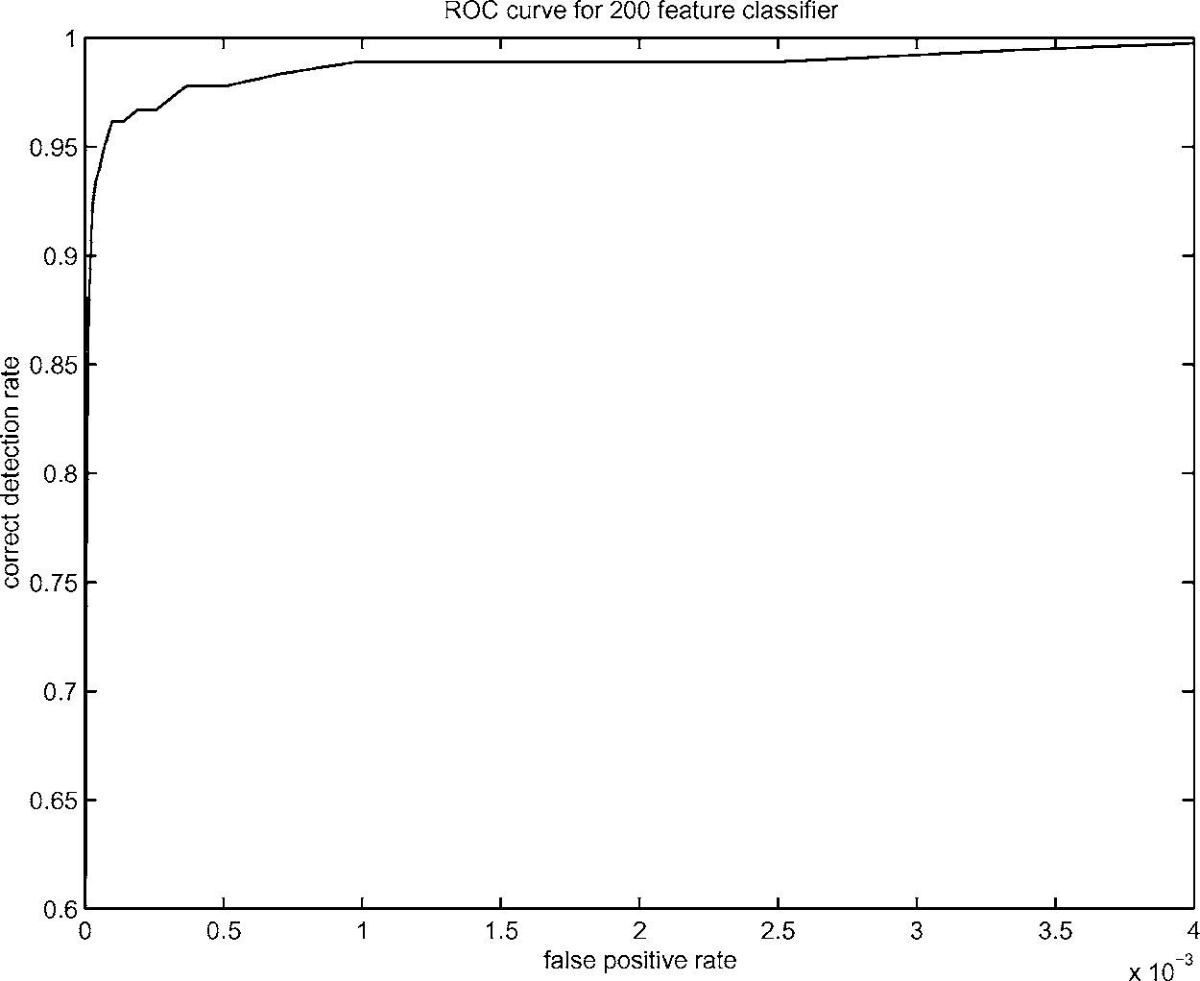
3.A Famous Object Detection -> Paul Viola, et al.
Performance
Receiver operating characteristic (ROC) curve
P. Viola and M. Jones. Rapid object detection using a boosted cascade of simple features. CVPR 2001.
P. Viola and M. Jones. Robust real-time face detection. IJCV 57(2), 2004.

Slide 27
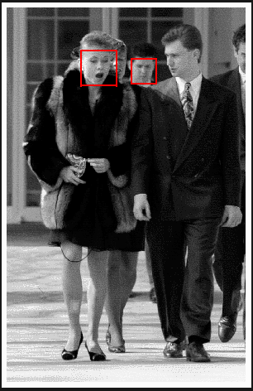
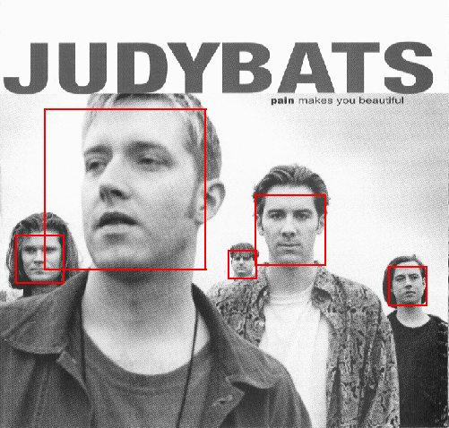
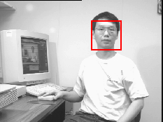
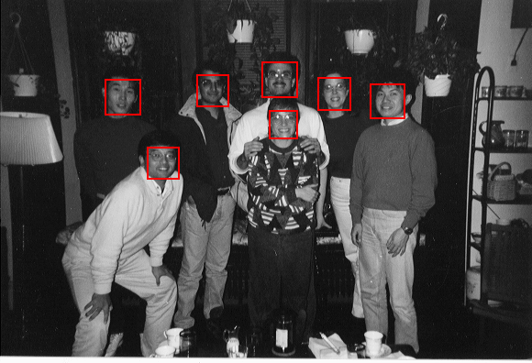
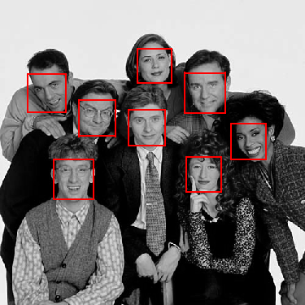
3.A Famous Object Detection -> Paul Viola, et al.
Results
P. Viola and M. Jones. Rapid object detection using a boosted cascade of simple features. CVPR 2001.
P. Viola and M. Jones. Robust real-time face detection. IJCV 57(2), 2004.

Slide 28
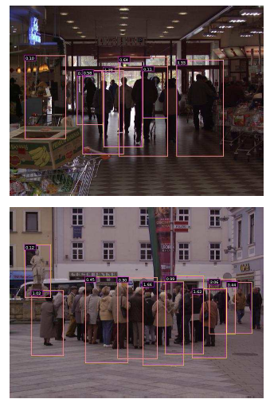
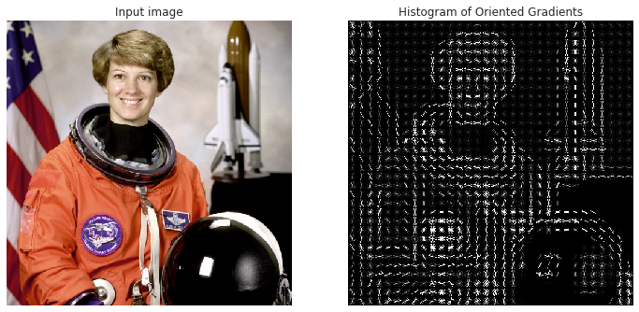
4.A Famous Human Detection -> HOG
Histograms of Oriented Gradients for Human Detection
Navneet Dalal and Bill Triggs, "Histograms of Oriented Gradients for Human Detection" CVPR05

Slide 29
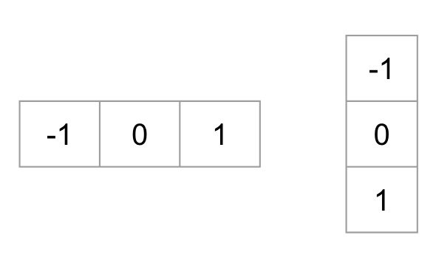
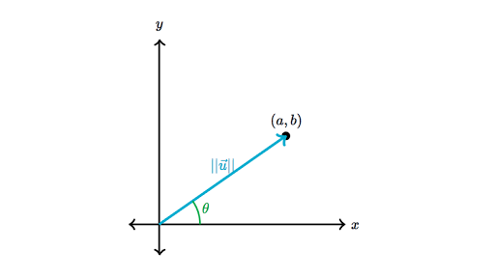
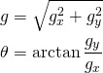
4.A Famous Human Detection -> HOG
Histograms of Oriented Gradients for Human Detection
Histogram of oriented gradients
Using local gradients to represent positive and negative examples
Navneet Dalal and Bill Triggs, "Histograms of Oriented Gradients for Human Detection" CVPR05

Slide 30
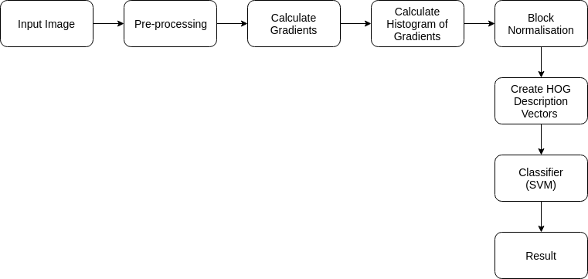
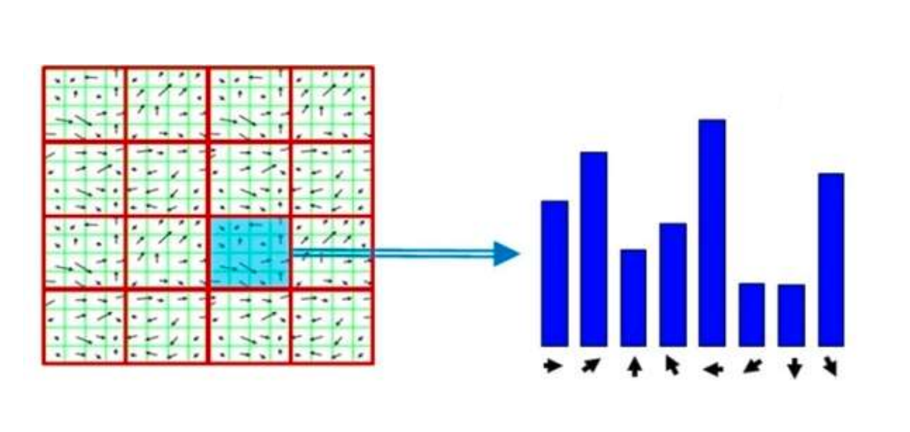
4.A Famous Human Detection -> HOG
Histograms of Oriented Gradients for Human Detection
Navneet Dalal and Bill Triggs, "Histograms of Oriented Gradients for Human Detection" CVPR05

Slide 31
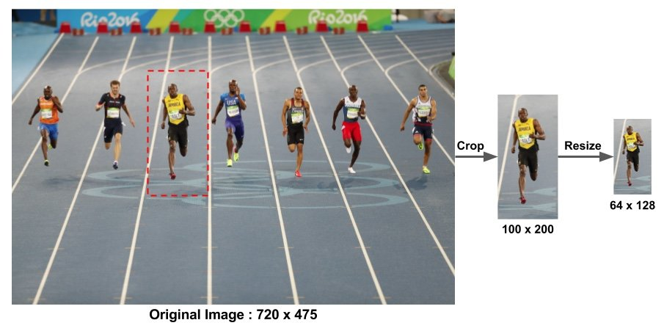
4.A Famous Human Detection -> HOG
Histograms of Oriented Gradients for Human Detection
Preprocessing
Navneet Dalal and Bill Triggs, "Histograms of Oriented Gradients for Human Detection" CVPR05

Slide 32
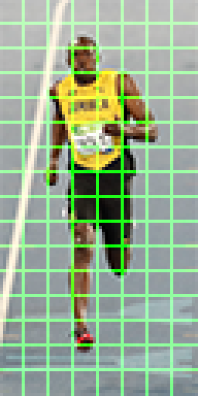
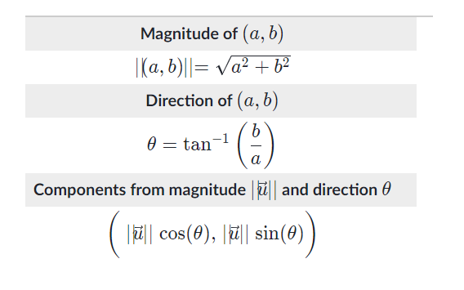
4.A Famous Human Detection -> HOG
Histograms of Oriented Gradients for Human Detection
Compute gradient in divided block 8x8
Navneet Dalal and Bill Triggs, "Histograms of Oriented Gradients for Human Detection" CVPR05

Slide 33
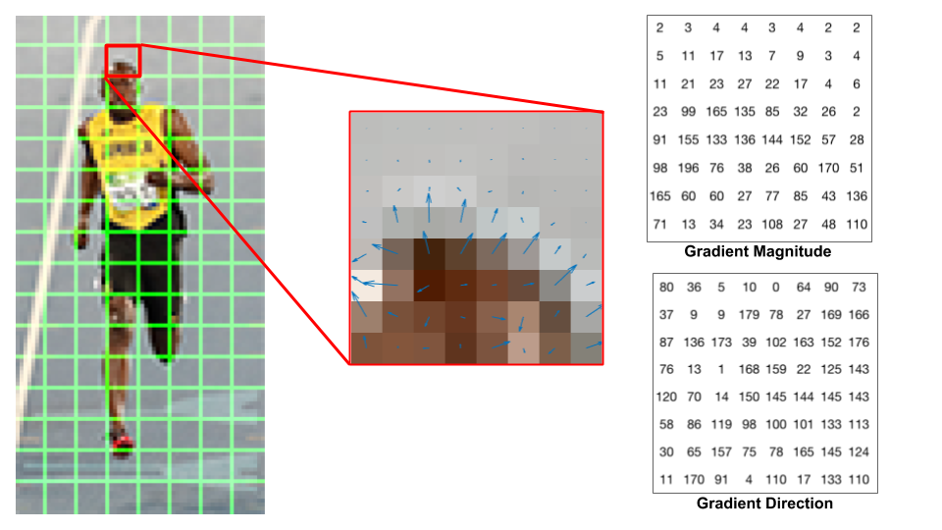
4.A Famous Human Detection -> HOG
Histograms of Oriented Gradients for Human Detection
Compute gradient in divided block 8x8
Navneet Dalal and Bill Triggs, "Histograms of Oriented Gradients for Human Detection" CVPR05

Slide 34
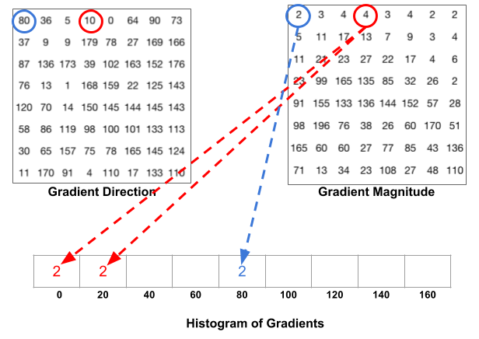
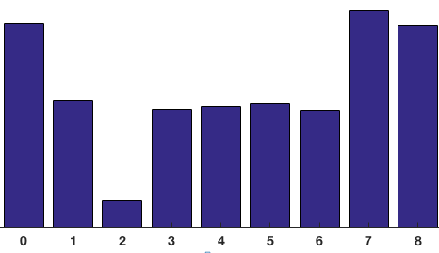
4.A Famous Human Detection -> HOG
Histograms of Oriented Gradients for Human Detection
Vote into 9 bins
Navneet Dalal and Bill Triggs, "Histograms of Oriented Gradients for Human Detection" CVPR05

Slide 35
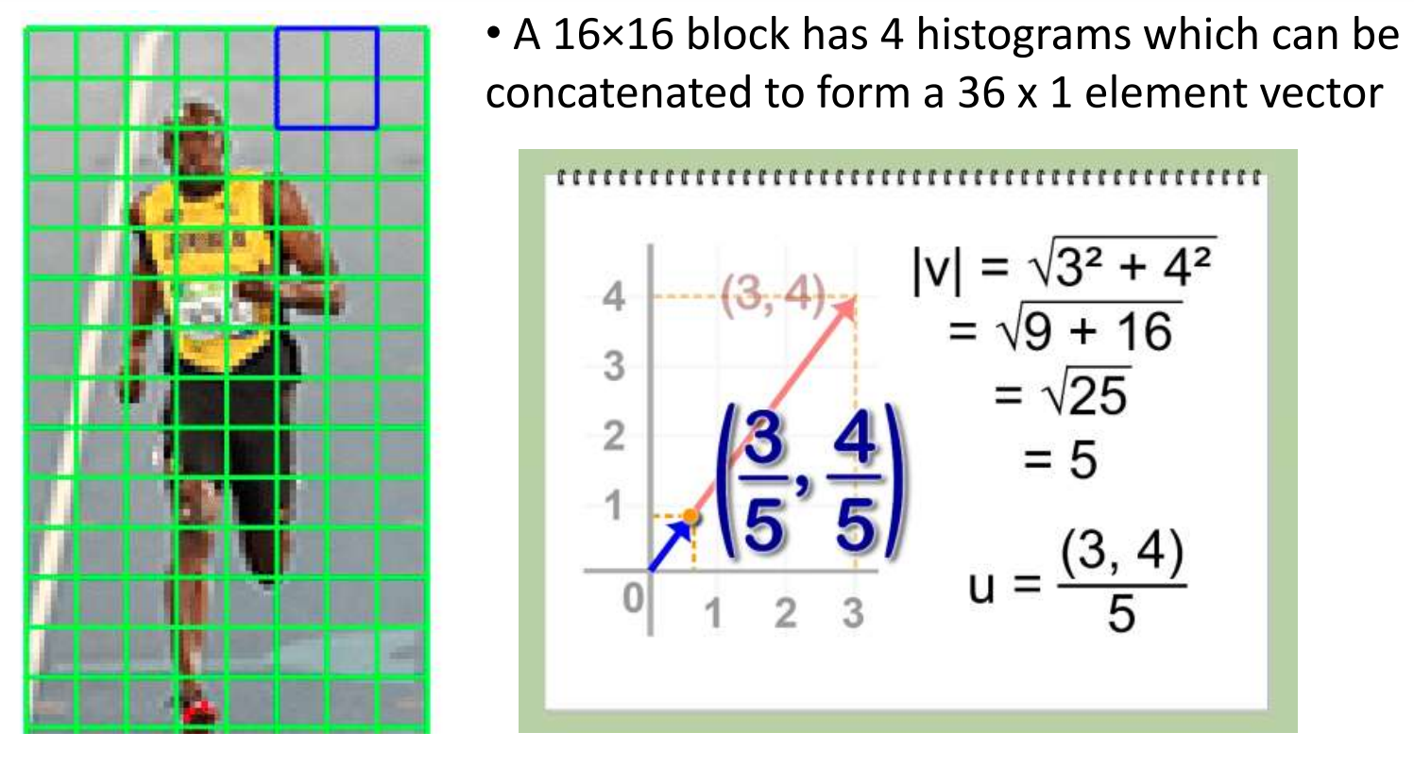
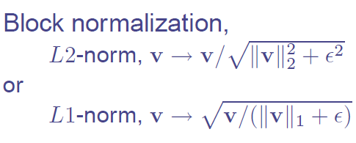
4.A Famous Human Detection -> HOG
Histograms of Oriented Gradients for Human Detection
Contrast Normalize in each Overlapped Block
Normalize the histogram so they are not affected by lighting variations.
Normalizing a vector removes the scale.
-> 9 bins x 4 blocks = 36
Navneet Dalal and Bill Triggs, "Histograms of Oriented Gradients for Human Detection" CVPR05

Slide 36
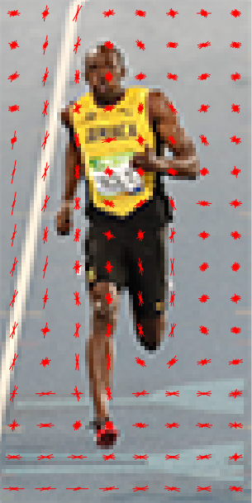
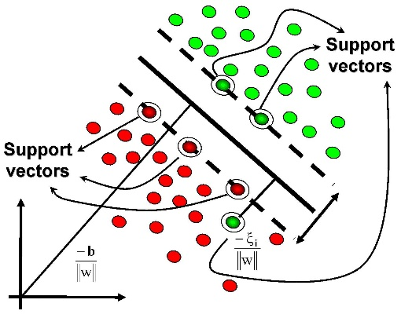
4.A Famous Human Detection -> HOG
Histograms of Oriented Gradients for Human Detection
Build to Feature Vector and Train with SVM
7 x 15 Overlapped Blocks x 36 Feature vectors = 3780 Feature vectors
Train with SVM / Positive / Negative samples
Navneet Dalal and Bill Triggs, "Histograms of Oriented Gradients for Human Detection" CVPR05

Slide 37
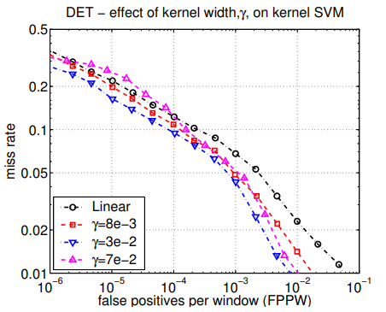
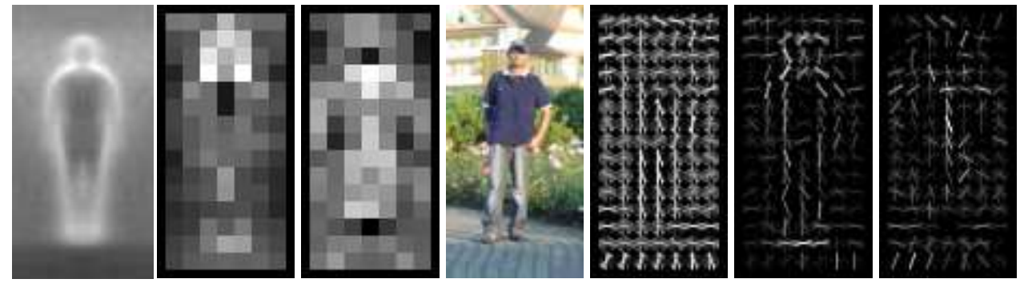
4.A Famous Human Detection -> HOG
Histograms of Oriented Gradients for Human Detection
Result
Navneet Dalal and Bill Triggs, "Histograms of Oriented Gradients for Human Detection" CVPR05

Slide 38
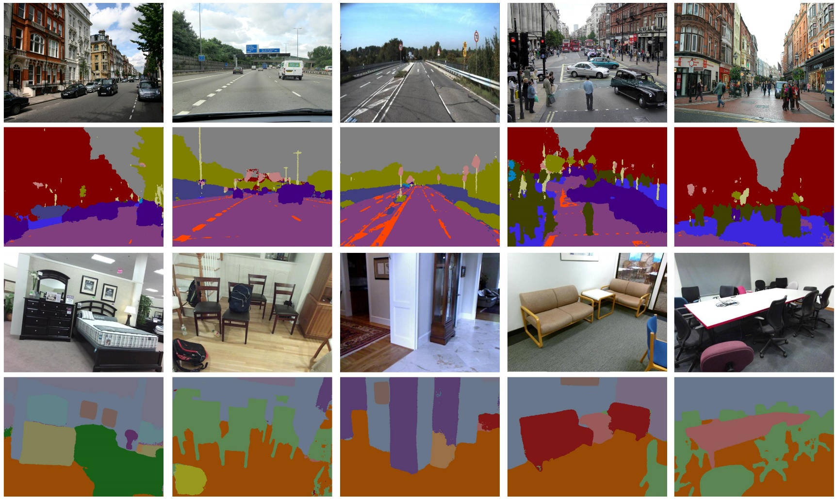
5. Machine Segmentation - Segnet
SegNet is a deep encoder-decoder architecture for multi-class pixelwise segmentation researched and developed by members of the Computer Vision and Robotics Group at the University of Cambridge, UK.

Slide 39
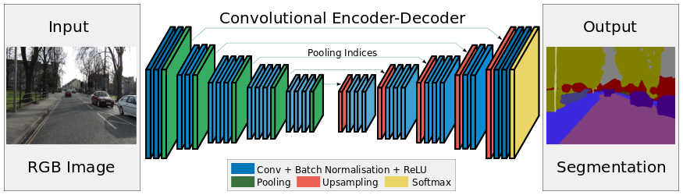
5. Machine Segmentation - Segnet

Slide 40
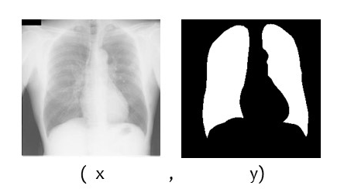
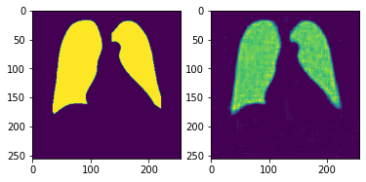

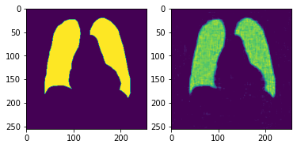

5. Machine Segmentation - Segnet
Lungs Segmentation

Slide 41
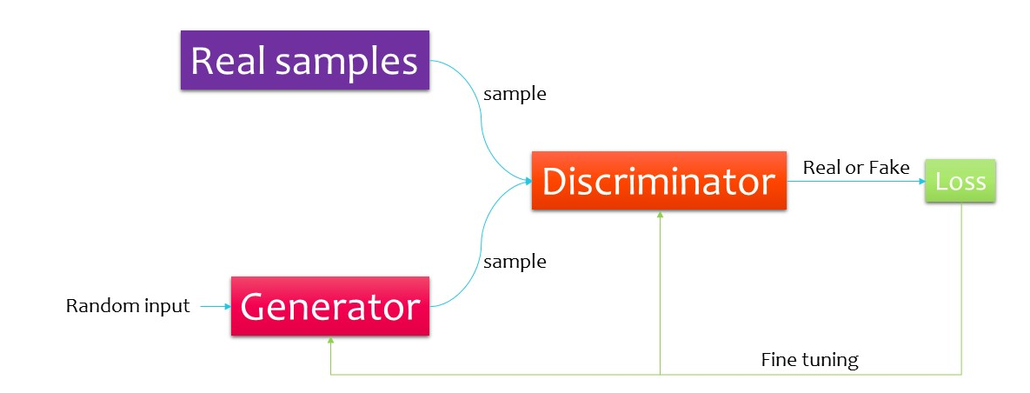
6. Generative Adversarial Networks
Generative Adversarial Networks : GAN
Generate new data with different properties (Supervised)
Included 1) Generator 2) Discriminator

Slide 42
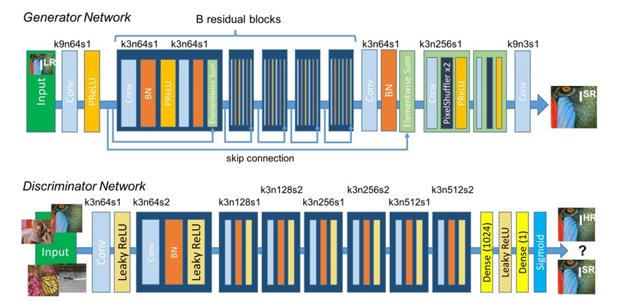
6. Generative Adversarial Networks
SRGAN – Super Resolution

Slide 43
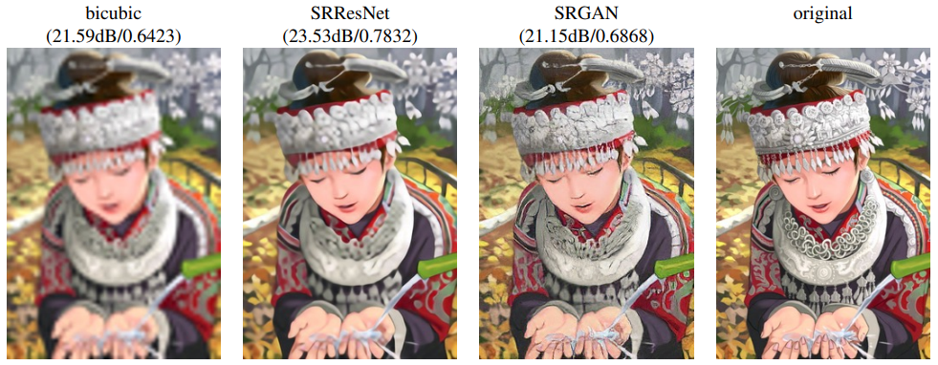
6. Generative Adversarial Networks
SRGAN Application

Slide 44
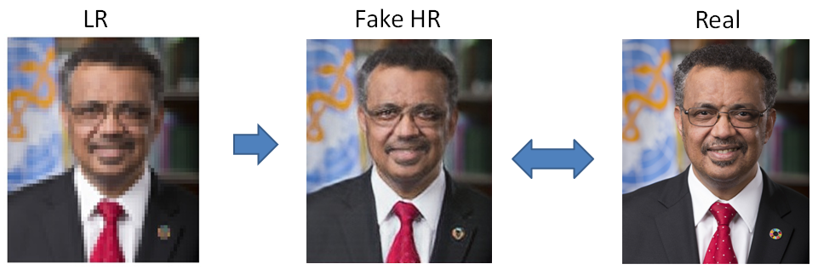
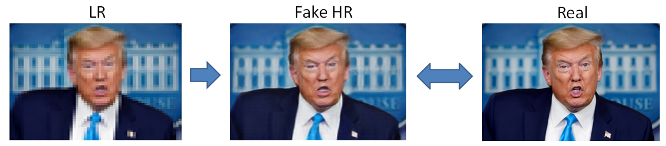
6. Generative Adversarial Networks
SRGAN Application
IMG REF :: https://medium.com/@peaceful0907/generative-adversarial-network-and-super-resolution-gan-srgan-e2e7a4440066

Slide 45
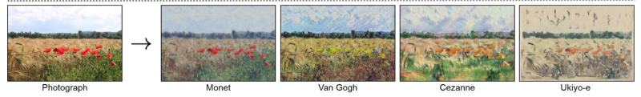


6. Generative Adversarial Networks
GAN Application
Generate Examples for Image Datasets
Generate Photographs of Human Faces
Generate Realistic Photographs
Generate Cartoon Characters
Image-to-Image Translation
Text-to-Image Translation
Semantic-Image-to-Photo Translation
Face Frontal View Generation
Generate New Human Poses
Photos to Emojis
Photograph Editing
Face Aging
Photo Blending
Super Resolution
Photo Inpainting
Clothing Translation
Video Prediction
3D Object Generation
https://machinelearningmastery.com/impressive-applications-of-generative-adversarial-networks/

Slide 46





7. Pose Estimation
OpenPose
https://github.com/CMU-Perceptual-Computing-Lab/openpose

Slide 47
Q / A
ถามตอบข้อสงสัย

